Slide 1

The Millikan Oil Drop Experiment
University Physics Experiment Center UESTC

Slide 2
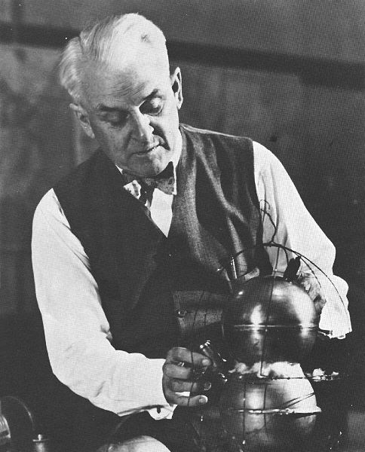
The Millikan Oil Drop Experiment
Beginning in 1907, Millikan (won the 1923 Nobel Prize in physics) proceeded with the measurement of electronic charge.
The experimental equipment is simple and effective.
The idea and method are elegant and concise.
The macroscopic mechanics model is used to study the quantum properties of the microscopic world.
The data are accurate and stable, which is praised as the model of experimental physics.

Slide 3
The Millikan Oil Drop Experiment
Experiment content
Aim
2. Principle
3. Experiment set-up
4. Process and cautions
5. Data and discussion
6. Exercise

Slide 4
1.Aims
1 Aims
Study on the Design of Millikan Oil Drop Experiment.
By measuring the movement of the charged oil droplets in the gravitational field and the electrostatic field, the charge discontinuity is verified and the fundamental charge value.
Through the adjustment of experimental instruments, the selection of oil droplets, tracking and measurement, as well as experimental data processing, training scientific experimental attitude.

Slide 5
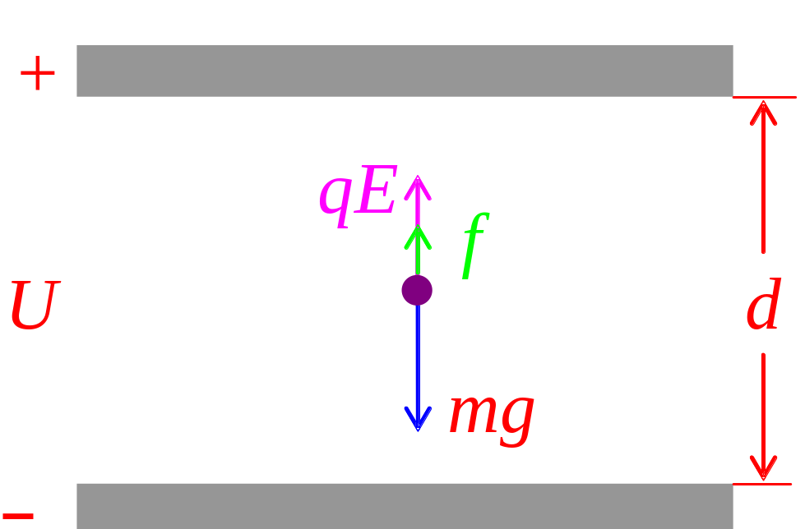
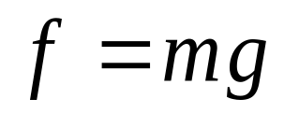
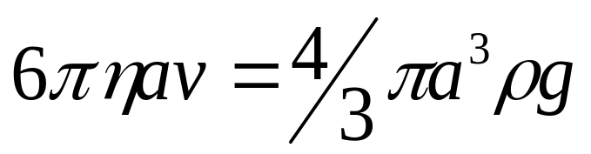
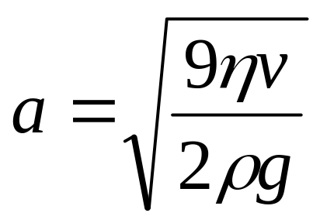
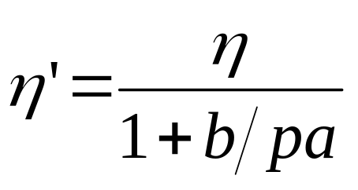
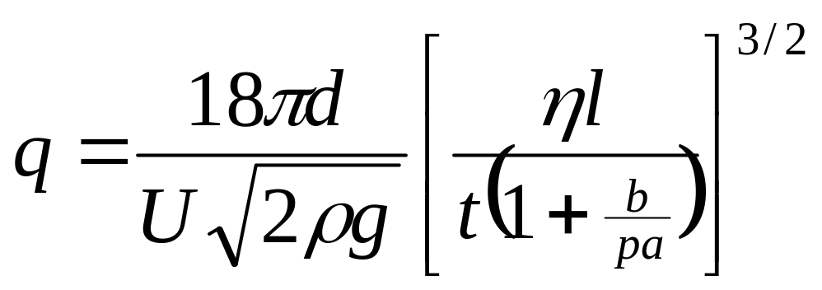
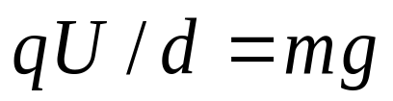
2.principle
2 principle
2.1 U=0，drop with uniform speed
Force balance
For：
as
Correct the viscous coefficient
2.2 U≠0时，Oil droplets still

Slide 6

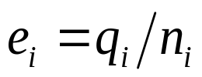
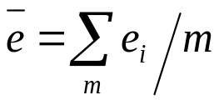
2.principle
2.3 discussion
2.3.1 Several known charge amount of the oil droplets q_{i}，for calculate e
Solve the greatest common divisor
*difficult
*for measurement error，no greatest common divisor exists！
(2) (assuming initial value and constant correction)
（a）assuming and initial value e₀
（b）
（c）
（d）
(3) How to assume the initial value of e0 is more reasonable ？
Request！
⊙Oil droplets with a smaller amount of electricity
⊙Sampling oil droplets enough

Slide 7
2.principle
2.3.2 choose oil
Principle: less charged, the measurement is more accurate.
(1)Uniform speed：2cm between 10s-30s
bigger，faster the oil drops
Too big oil，more error for measurement
Too small oil， Brownian motion is evident
(2)Balance voltage between 100V-300V
The equilibrium voltage depends on the amount of charge
Little the charged quantity , more balance voltage, vice versa
(3)Conclusion: charged quantity should be 2-10.
(4)Drop time and voltage should not be the same, avoiding the same charged quantity.
(5) Advice：first set voltage for 200V，inject the oil, and wait for moment, choose the suitable oil, which have slow motion for experiment.

Slide 8
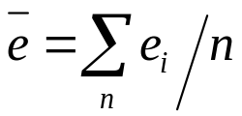
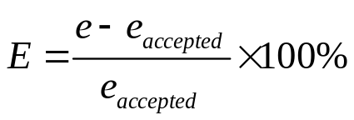
2.principle
2.3.3 How to Evaluate Error
Processing：
（a）Assuming current accepted value e₀=e_{accepted}
（b）
（c）
（d）
（e）

Slide 9
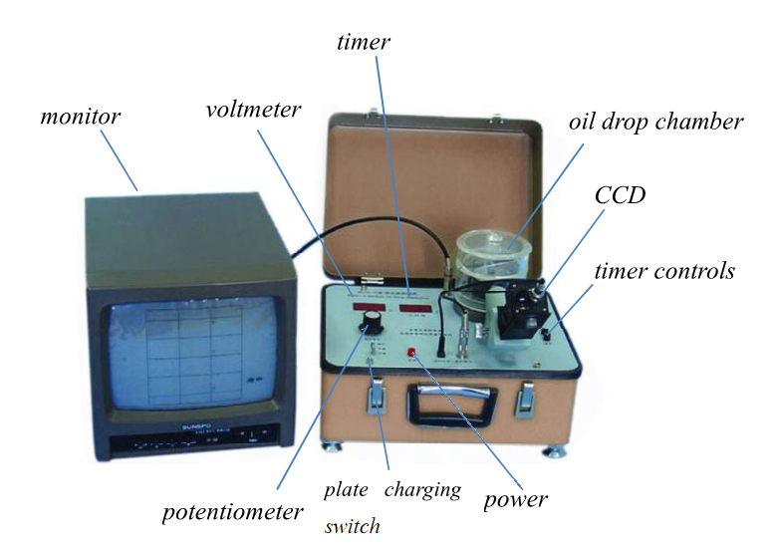
3.Equipment set-up
3 Equipment set-up

Slide 10
4.Process and cautions
4 Process and cautions
(1) Adjust the camera angle, for scale line horizontal and vertical.
(2) Sprayer must keep the nozzle up or obliquely above.
(3) Adjust the CCD focal length, to ensure clearly oil droplets.
(4) Control movement of oil, to achieve oil measured several times.
(5) Checking，any oil droplets charged more than 10e, should be removed, re-select the appropriate oil droplets
(6) Be patient in the measurement process.

Slide 11
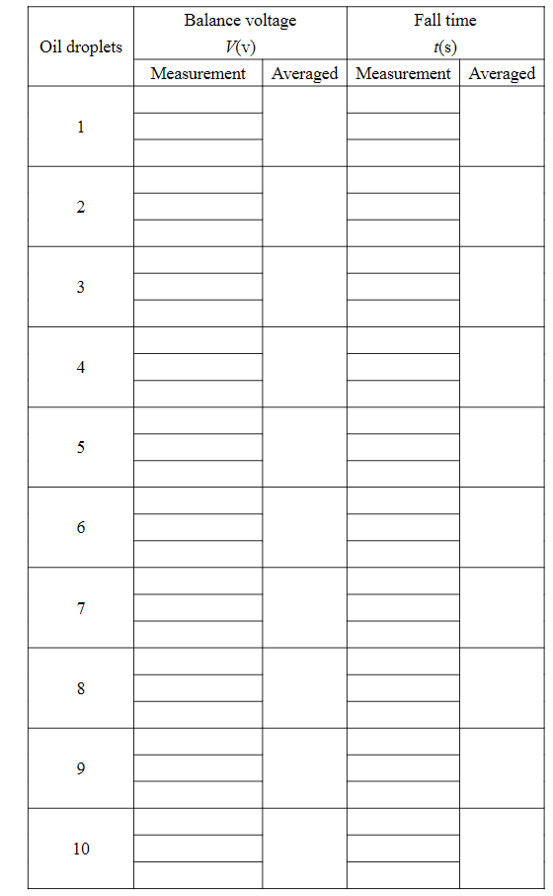
5.Data and process
5 Data and process

